Slide 1
Deep learning for biological data
Mgr. Vlastimil Martinek
Mgr. David Cechak

Slide 2

Goals of the Workshop
Machine learning basics
Demystify deep learning
Pre-Processing genomic data
Programming neural nets for genomics
Out of Scope
Heavy math
Easiest way to do/use neural networks
Elaborate architecture and training schemes
Interpretability
Able to deploy inference server

Slide 3
Agenda
Introduction
Linear regression
Logistic regression classifier
Multilayer perceptron (MLP)
Convolutional neural network (CNN)
Extras
Notes:
Perceptron - a computer model or computerized machine devised to represent or simulate the ability of the brain to recognize and discriminate.

Slide 4


Workshop Tools

Slide 5
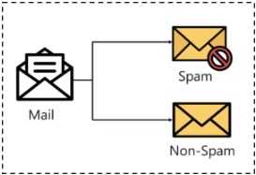
Solving a problem
f(X) = y
X = biological sequence, microscopy image, molecule, text, map as a graph…
y = contains a gene?, tumor position and volume, binding site, shortest path…
f traditionally designed by hand
What if we let a machine design the funcion f?
Goal: have a useful predictor
Notes:
Img source https://www.edureka.co/blog/classification-in-machine-learning/

Slide 6

Linear regression

Slide 7
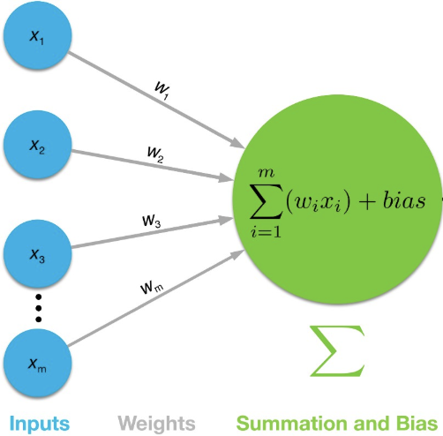
Linear regression
Output
Notes:
Linear regression - with multiple variables

Slide 8
Optimization process - fitting our data
Error = MSE
Y = mX+b

Slide 9

Practical part
https://github.com/BioGeMT/MALTAomics-Summer-School/
Day 2 Workshop
MALTA_01 Notebook
Notes:
Walk through every line

Slide 10
Task: Learn Optimal Weights to Minimize Loss
Input Data
Weights
Model
Weight update
Prediction Y’
Reality Y
Optimizer
Loss

Slide 11
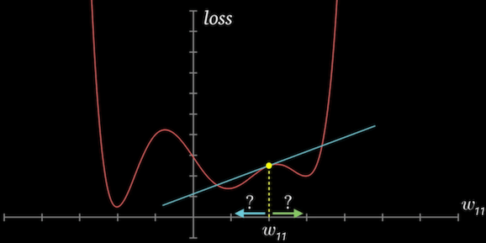
Gradient descent
Compute a gradient for a single weight w.r.t the loss
Average over the training data
Indicates the rate of change
weight = weights - weight.grad * 1e-5
bias = bias - bias.grad * 1e-5
Notes:
Source https://jovian.com/aakashns/02-linear-regression

Slide 12
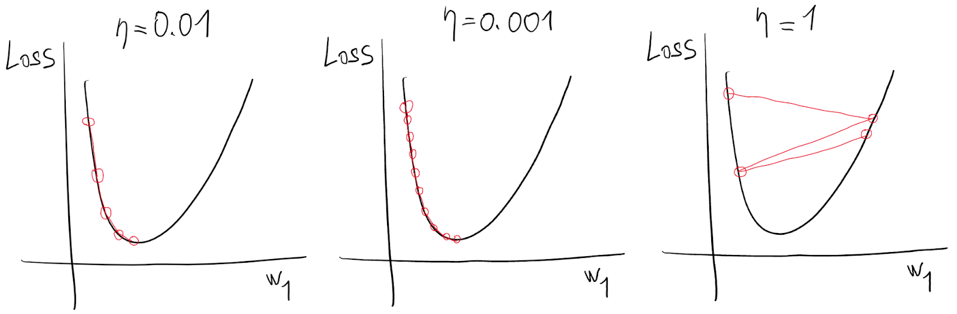
Epochs, learning rate, loss function
Learning rate - magnitude of the weight update
Loss function - objective to minimize
Tensor - pytorch array able to track gradient
Epochs - number of cycles in the learning phase
Notes:
Back to code after this slide

Slide 13
Task: Learn Optimal Weights to Minimize Loss
Input Data
Weights
Model
Weight update
Prediction Y’
Reality Y
Optimizer
Loss

Slide 14
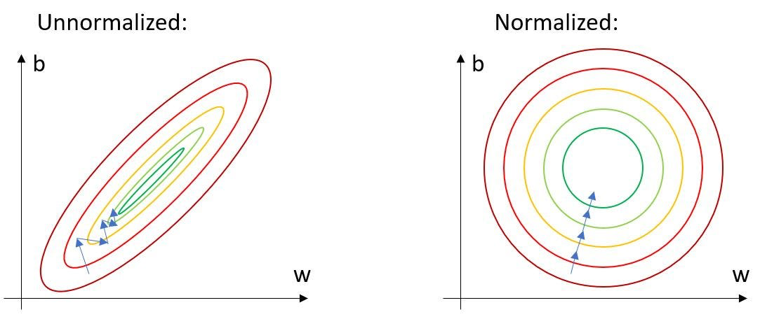

Slide 15
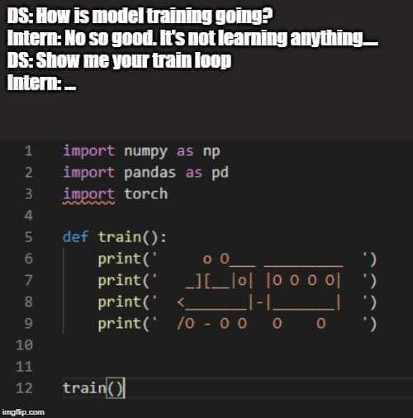
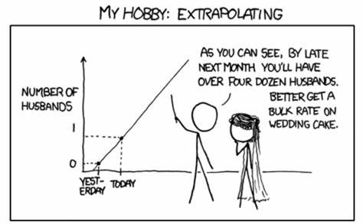
Short break.

Slide 16
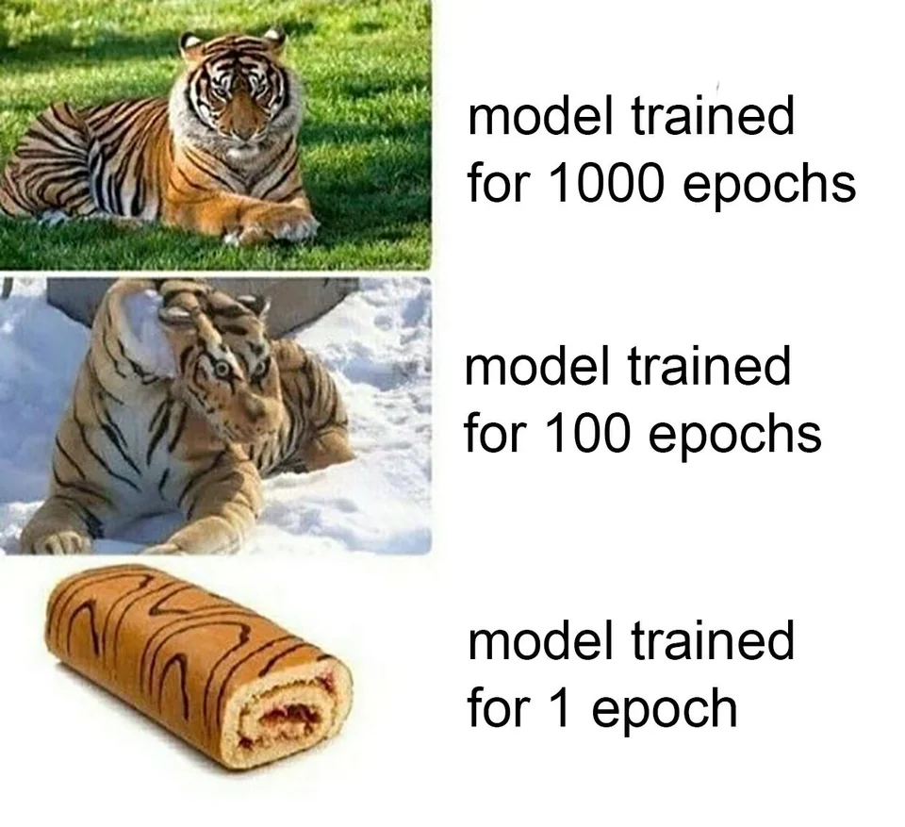
Quiz
1. What shape should be the training data for our Linear layer?
2. What is a loss function?
3. What is mean squared error?
4. What happens when you invoke the .backward function on the result of the mean squared error loss function?
5. How do you update the weights and biases of a model?

Slide 17
Quiz
6. Why do you reset gradients to zero after updating weights?
7. What is an epoch?
8. What is the benefit of training a model for multiple epochs?
9. What should you do if your model’s loss doesn’t decrease while training?
10. What are the inputs to a PyTorch optimizer?
11. How could we feed 2 features as input?

Slide 18
Linear regression summary
Y = wX + b
Regression problem
Common with deep learning
Needs input data
Starts with random weights/parameters
Computes loss
Repeatedly optimizes loss to improve (a tiny bit) on training data (epochs)
Resulting model has updated weights
Differences
Linear only

Slide 19
Classification
Logistic regression

Slide 20
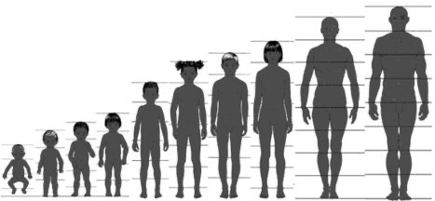
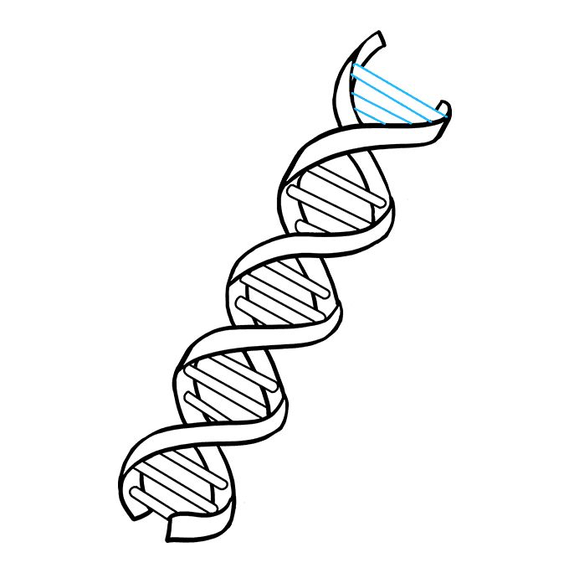
Is this DNA sequence a non-TATA promoter?
f(X) = y
X = height
y = weight?
f(X) = y
X = DNA sequence
y = contains a non-TATA promoter?
Notes:
The TATA box, a core promoter element, plays a pivotal role in the initiation of transcription. TATA-containing promoters often drive burst-like gene expression, whereas TATA-less promoters typically govern housekeeping genes. Distinguishing between TATA and non-TATA promoters is crucial, as it provides insights into gene regulation, expression dynamics, and potential disease associations
One-hot
For a dataset consisting of N elements (the elements can be characters (ACTG), tokens (n-grams), words, digits, ...), a one-hot vector is a 1 × N vector (list) used to distinguish each word in a vocabulary from every other word in the vocabulary
The vector consists of 0s in all cells with the exception of a single 1 in a cell used uniquely to identify the word
One-hot encoding ensures an “equality” of the tokens - f.e. that ML does not assume that higher numbers are more important or that the order of numbers has any significance
The reason for just a single 1 and the rest are zeros --- mutually distinct features

Slide 21
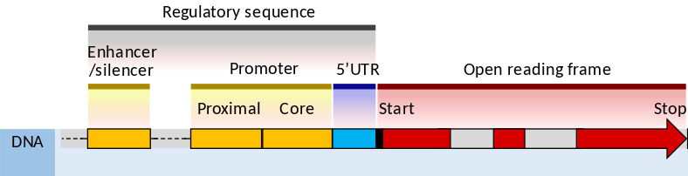
Promoter
Regulatory sequences
Where proteins bind to initiate transcription of a gene
TATA
drive burst-like gene expression
non-TATA
govern housekeeping genes - consistent expression
Notes:
The TATA box, a core promoter element, plays a pivotal role in the initiation of transcription. TATA-containing promoters often drive burst-like gene expression, whereas TATA-less promoters typically govern housekeeping genes. Distinguishing between TATA and non-TATA promoters is crucial, as it provides insights into gene regulation, expression dynamics, and potential disease associations
One-hot
For a dataset consisting of N elements (the elements can be characters (ACTG), tokens (n-grams), words, digits, ...), a one-hot vector is a 1 × N vector (list) used to distinguish each word in a vocabulary from every other word in the vocabulary
The vector consists of 0s in all cells with the exception of a single 1 in a cell used uniquely to identify the word
One-hot encoding ensures an “equality” of the tokens - f.e. that ML does not assume that higher numbers are more important or that the order of numbers has any significance
The reason for just a single 1 and the rest are zeros --- mutually distinct features

Slide 22
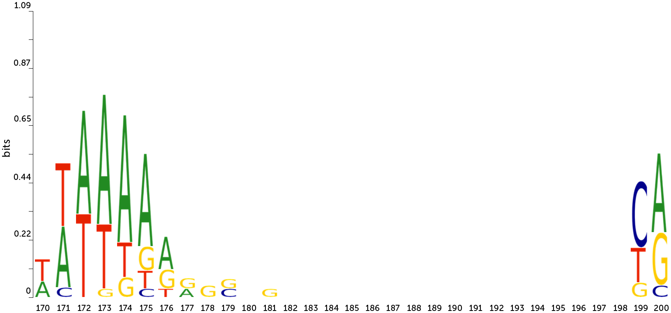
TATA-box region - motif
Sequence motif for human TATA promoter sequences
in the TATA-box region
Notes:
Source: https://journals.plos.org/plosone/article?id=10.1371/journal.pone.0171410

Slide 23
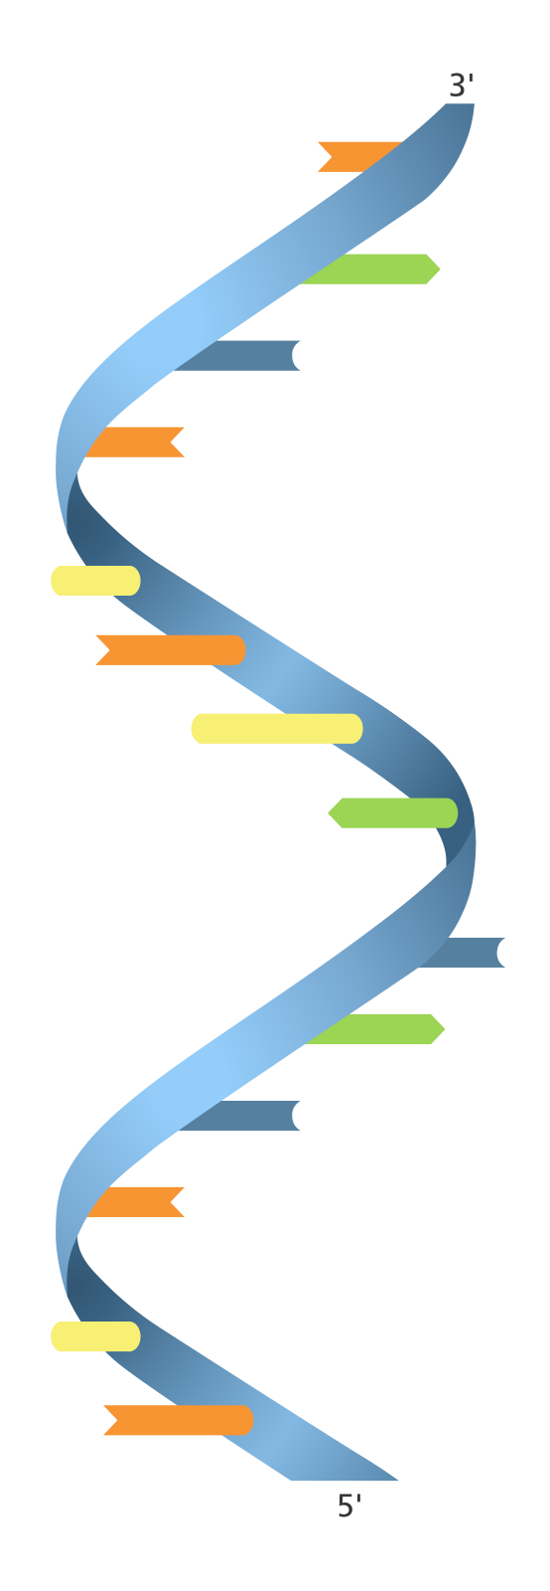
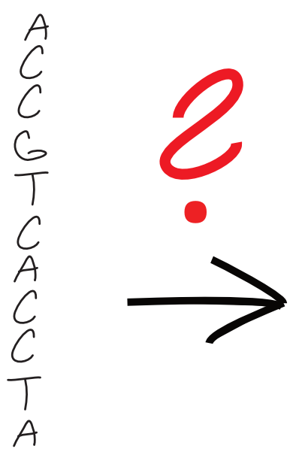
First problem: Numericalization -> Tokenization
Linear regression
Output
Notes:
One-hot
For a dataset consisting of N elements (the elements can be characters (ACTG), tokens (n-grams), words, digits, ...), a one-hot vector is a 1 × N vector (list) used to distinguish each word in a vocabulary from every other word in the vocabulary
The vector consists of 0s in all cells with the exception of a single 1 in a cell used uniquely to identify the word
One-hot encoding ensures an “equality” of the tokens - f.e. that ML does not assume that higher numbers are more important or that the order of numbers has any significance
The reason for just a single 1 and the rest are zeros --- mutually distinct features

Slide 24
Numericalization
& Tokenization
Input Data
Weights
Model
Weight update
Prediction
Reality
Optimizer
Loss

Slide 25
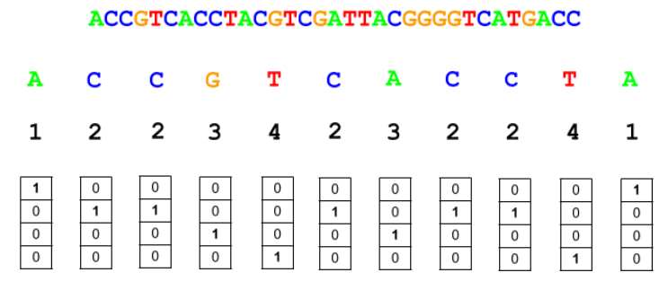
Numericalization & Tokenization
Notes:
One-hot
For a dataset consisting of N elements (the elements can be characters (ACTG), tokens (n-grams), words, digits, ...), a one-hot vector is a 1 × N vector (list) used to distinguish each word in a vocabulary from every other word in the vocabulary
The vector consists of 0s in all cells with the exception of a single 1 in a cell used uniquely to identify the word
One-hot encoding ensures an “equality” of the tokens - f.e. that ML does not assume that higher numbers are more important or that the order of numbers has any significance
The reason for just a single 1 and the rest are zeros --- mutually distinct features

Slide 26
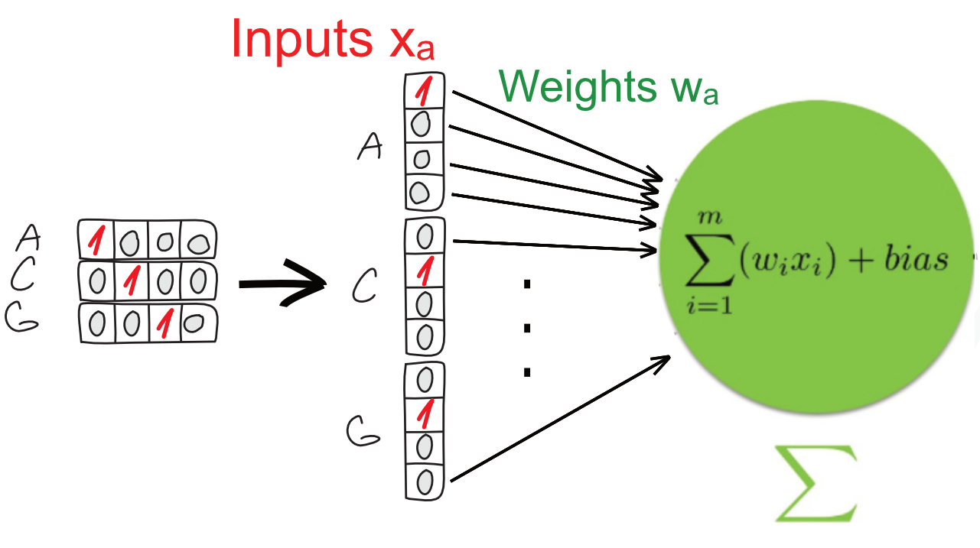

Slide 27
Logistic regression - DNA enhancers classification
https://github.com/BioGeMT/MALTAomics-Summer-School/
Day 2 Workshop
MALTA_02_DNA_enhancers.ipynb

Slide 28
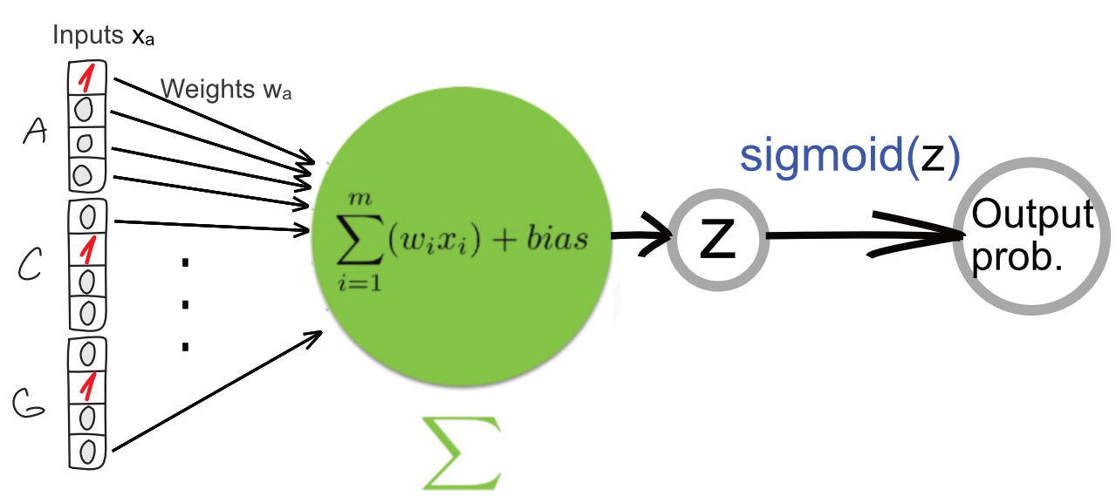

Slide 29
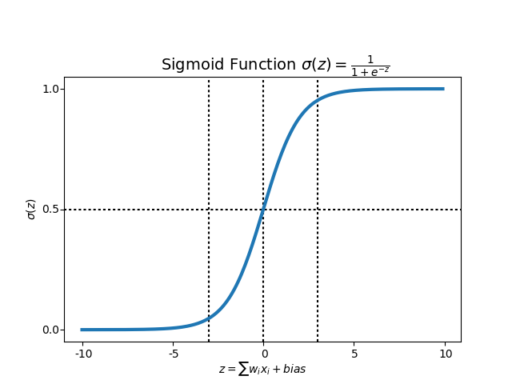

Slide 31
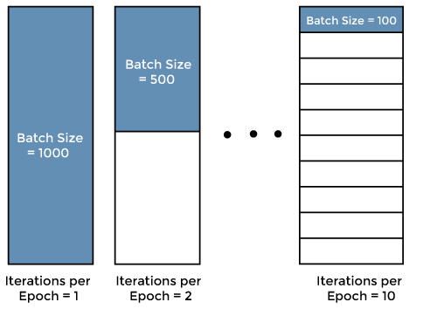
Batch size and shuffling
Input Data
Weights
Model
Weight update
Prediction
Reality
Optimizer
Loss
Batch size - speed VS stability of the learning process
Notes:
Source https://www.javatpoint.com/epoch-in-machine-learning

Slide 32
Loss functions and activations
Input Data
Weights
Model
Weight update
Prediction
Reality
 | Regression | Binary Classification
Loss function | MSE | Binary CE
Activation | None | Sigmoid
Optimizer
Loss

Slide 33
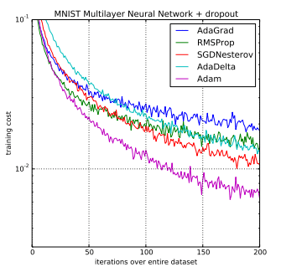
Adam optimizer
Input Data
Weights
Model
Converges faster than SGD
Uses momentum and moving average of the gradient
Computer per-weight learning rates
Weight update
Prediction
Reality
Optimizer
Loss
Notes:
Source
Adam: A Method for Stochastic Optimization, 2015.

Slide 34
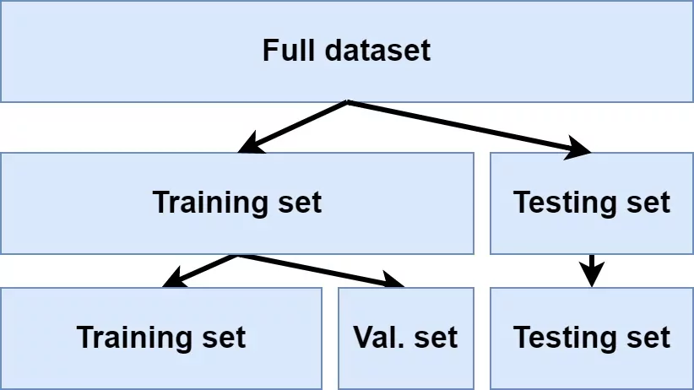
Dataset management
Input Data
Weights
Model
Weight update
Prediction
Reality
Optimizer
Loss
Notes:
Imagine NN remember each data point

Slide 35
Dataset management
Input Data
Weights
Model
Weight update
Prediction
Reality
Optimizer
Loss
Notes:
Imagine NN remember each data point

Slide 36
Multilayer Perceptron

Slide 37
Input Data
Weights
Model
Weight update
Prediction
Reality
Optimizer
Loss

Slide 38

Nonlinearity and hidden layers
We could stack Linear Regression
No more powerful
Only linear combinations
We need nonlinearity
Dense layer = every neuron is connected to all neuron from the previous layer

Slide 39
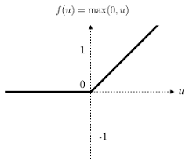
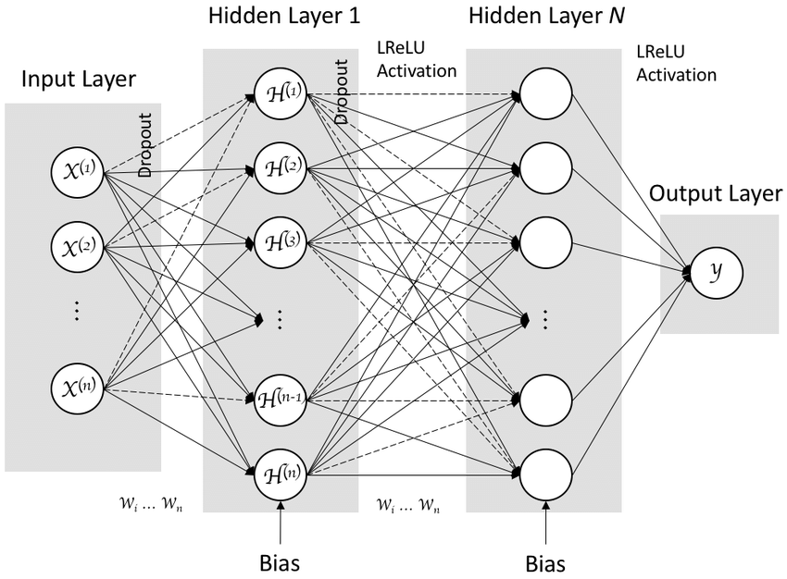
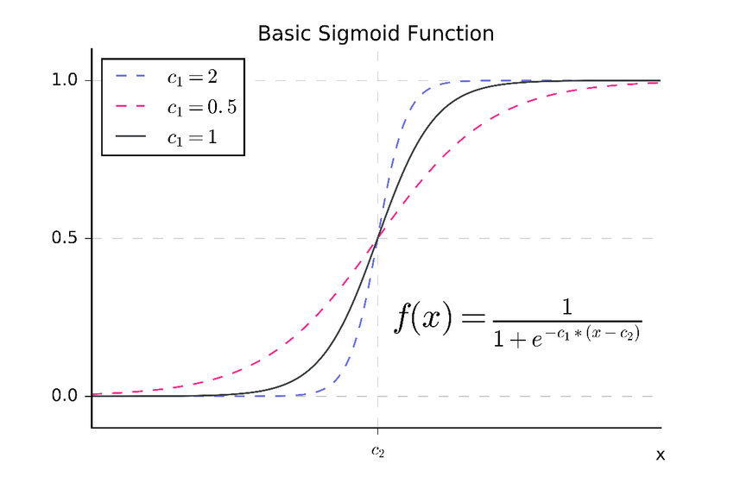
Multilayer Perceptron (MLP)
Hidden Layer Activation:
ReLU
Sigmoid
activation
Output Layer Activation:
Sigmoid
Notes:
We start with random weights, get some prediction and improve on it (we want high values where true label is)
Source
https://www.researchgate.net/figure/MLP-deep-learning-architecture_fig5_321341597
https://www.researchgate.net/figure/A-Basic-sigmoid-function-with-two-parameters-c1-and-c2-as-commonly-used-for-subitizing_fig2_325868989

Slide 40
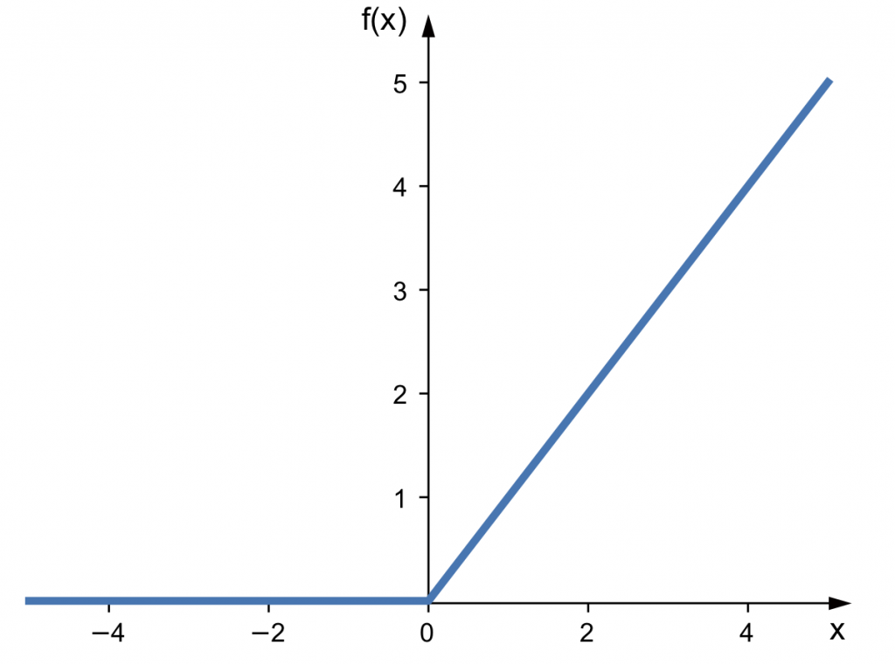

Slide 41
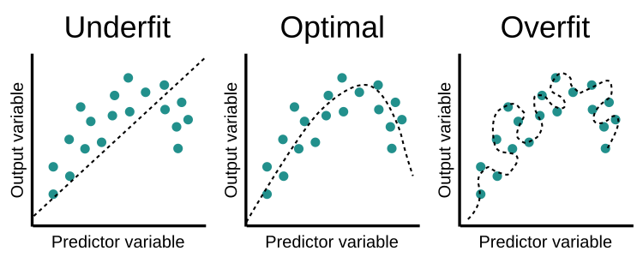
Overfitting

Slide 42
Quiz
What are the benefits of shuffling the training data before creating batches?
What is the reason for adding nonlinearity?
What should be the output of an NN if we want to do classification?

Slide 43
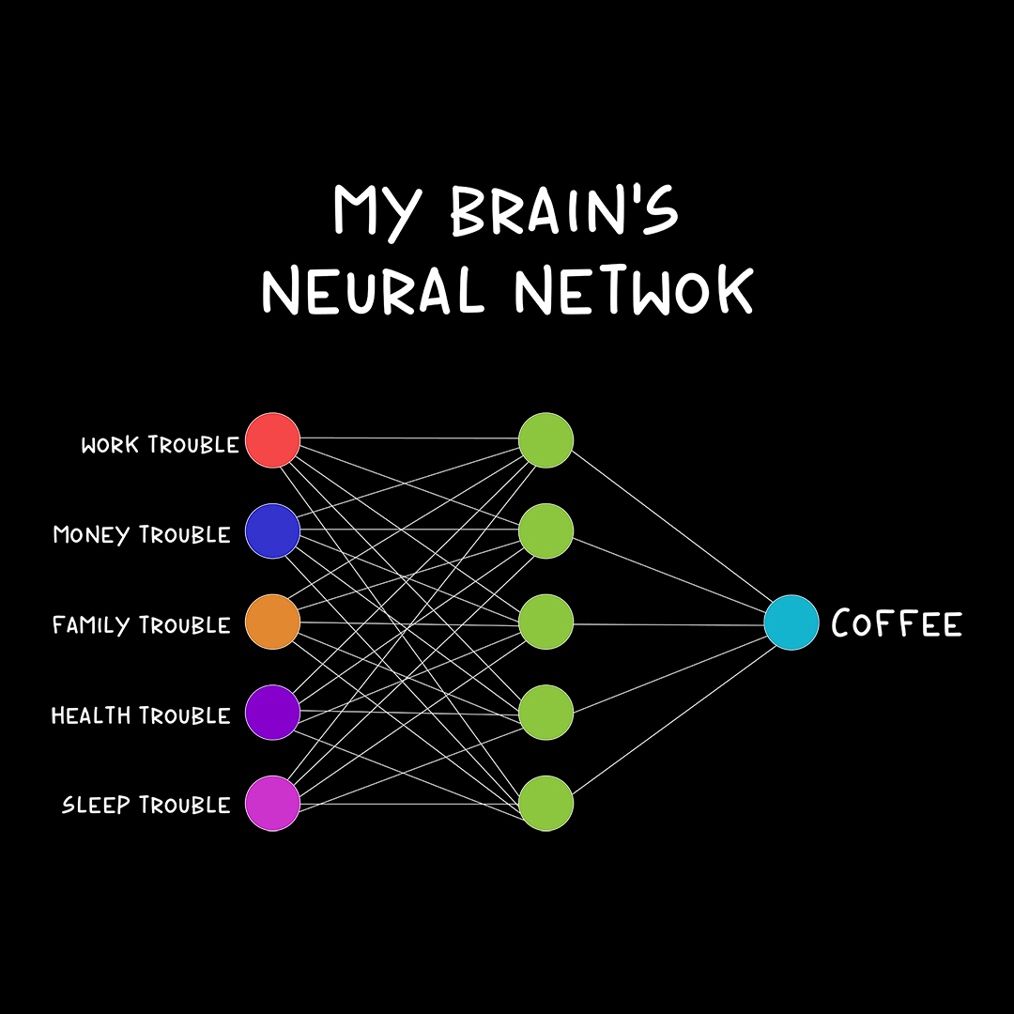
Short break.
Back at ….

